Slide 1
Need to requirements
Voice of Customer | Need | Requirements
We need a streamlined and integrated data analysis and visualization solution within Power BI. The current process relies heavily on Excel macros, which are cumbersome. Data sources are not easily modifiable or retrievable, and the graphical presentation is not straightforward. Additionally, we need dynamic date handling and the ability to link multiple data sources for comprehensive analysis | Eliminate dependence on Excel macros. Seamless data source integration Enhanced graphical presentation Enable dynamic data handling. Comprehensive data analysis capabilities | Implement data transformation in Power Query Create a key column and master table. Develop complex data models. Design reports with customer-specific fonts, colors, and designs Use column charts, matrix visuals, drill-through features, and combination charts.

Slide 2


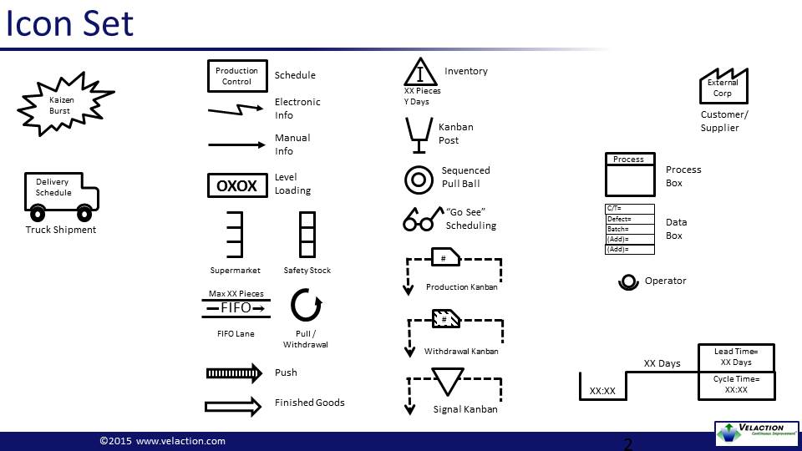
Value stream map – PSI Repairs
Production Control
Resources
Supplier
Daily Schedule
Updated Dashboard
Refresh Power BI
Data Refresh
Data Query Execution
Data Transform
Data Modelling
Visualization
Report & Distribution
1
1
1
1
1
1
60 seconds
90 seconds
120 seconds
150 seconds
180 seconds
60 seconds
VA: 50 sec
ENVA: 5 sec
NVA: 5 sec
VA: 70 sec
ENVA: 10 sec
NVA: 10 sec
VA: 90 sec
ENVA: 20 sec
NVA: 10 sec
VA: 110 sec
ENVA:20 sec
NVA: 20 sec
VA: 140 sec
ENVA: 30 sec
NVA: 10 sec
VA: 50 sec
ENVA: 5 sec
NVA: 5 sec
Total Cycle Time = 660 seconds
Value Added Time = 510 seconds
Process Cycle Efficiency = VA/Total Time = 600/900 = 72.27%

Slide 3
Impact Comparison
Parameter | Before Automation | After Automation
Process Steps | Manual data retrieval, consolidation, transformation, analysis, report generation, and distribution. | Automated data fetching, transformation, analysis, and report generation in Power BI.
Cycle Time | 5400 Seconds (90 Minutes) | 660 Seconds (11 Minutes)
Value-Added (VA) Time | 1150 Seconds (Actual Analysis) | 510 Seconds
Essential Non-Value-Added (ENVA) Time | 3000 Seconds (Data Prep, Transformation) | 90 Seconds
Non-Value-Added (NVA) Time | 1250 Seconds (Manual Efforts, Waiting Time) | 60 Seconds
Efficiency Improvement | (1150 / 5400) * 100 = 21.30% | (510 / 660) * 100 = 72.27%

Slide 4
Net impact calculation
Time Saved per Cycle: 5400 seconds - 660 seconds = 4740 seconds (79 minutes)
Per Person:
Manual cycles per week: Assume 5 cycles.
Time saved per week per person: 5 cycles * 79 minutes = 395 minutes (6.58 hours).
Time saved per week for 40 persons: 6.58 hours * 40 = 263.2 hours.
Total Time Saved per Week: 263.2 hours.
Total Time Saved per Year: 263.2 hours * 52 weeks = 13686.4 hours.

